Slide 1
Customer Data Analysis
Tools Used: SQL, Power BI
Prepared By: Vijay Raghavendra
Project ID: PTID-CDA-DEC-25-956
Mentor: Datamites

Slide 2
Introduction
This project involves analyzing customer purchase data to understand patterns across gender, age groups, product categories, and payment methods. Using SQL for data extraction and Power BI for visualization, the goal is to generate insights that help in improving customer segmentation, sales strategy, and business decision-making.

Slide 3
Project Objectives
1
Analyze total revenue, orders, customers, and quantity.
2
Identify the most profitable customer segments.
3
Understand customer purchase behavior across gender and age groups.
4
Analyze payment method preferences.
5
Determine high-performing product categories.
6
Build an interactive Power BI dashboard for decision-making

Slide 4
Dataset Overview
Source:
Attributes:
Datamites Customer Segmentation Database
invoice_no
Table:
customer_id
gender
customer
age
category
quantity
price
payment_method
invoice_date
shopping_mall
The data contains 1000 customer transactions from multiple categories and demographics.

Slide 5
Data Preparation (SQL + Power BI)
SQL Tasks Performed:
Power BI Preparation:
Removed duplicates
Imported SQL table
Checked for null values
Converted data types
Verified valid ranges for age, price, quantity
Created measures (DAX)
Extracted transactional insights
Designed interactive slicers (Gender, Age Group, Category, Payment Method)
Created cleaned dataset for Power BI

Slide 6
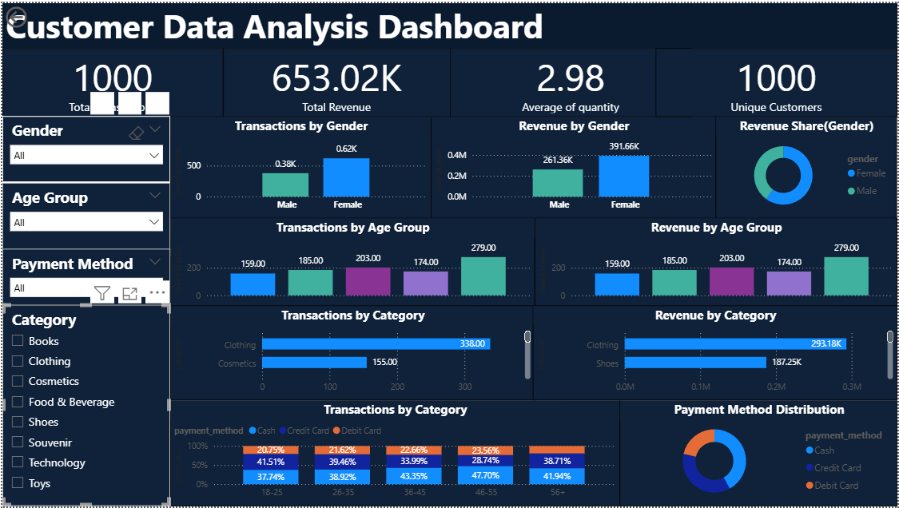
Dashboard Overview

Slide 7
KPI Summary
Dashboard displays 4 major KPIs:
653.02K
1000
2.98
2.37K
Total Revenue
Total Orders
Average Quantity
Avg Order Value

Slide 8
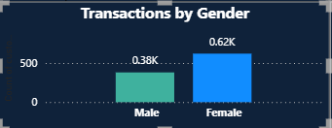
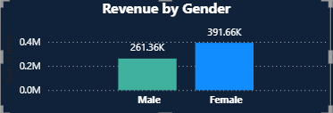
Gender Analysis (Charts)
Key Insights:
Business Conclusion:
Female customers contribute more revenue than males.
Businesses should focus more promotions and offers toward female shoppers to further boost revenue.
Female customers also purchase more quantity.
Gender revenue share:
Female: higher
Male: lower

Slide 9
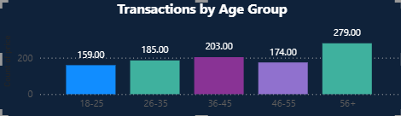
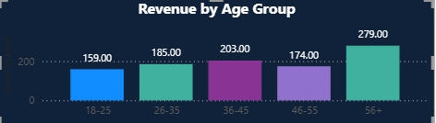
Age Group Analysis
From The charts:
Insights:
Age group 46-60 has the highest revenue.
Older age groups tend to make higher-value purchases.
Young adults 18-25 contribute least.
Younger groups may need targeted, low-cost promo offers.
Age group 26-35 is the second most active.

Slide 10
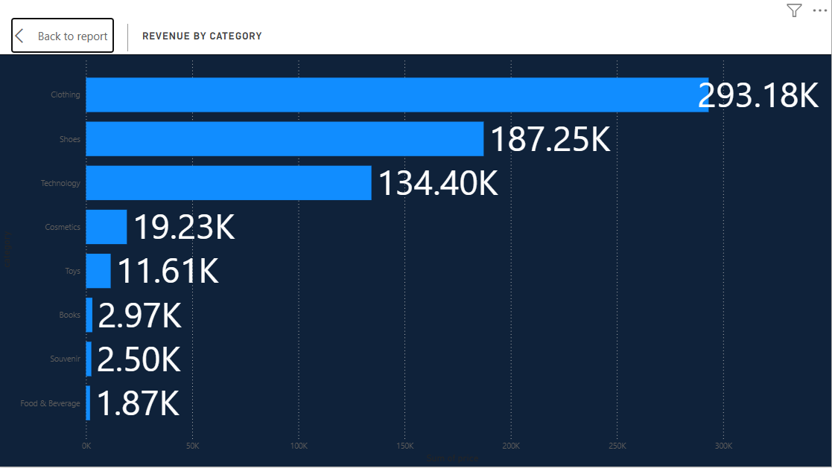
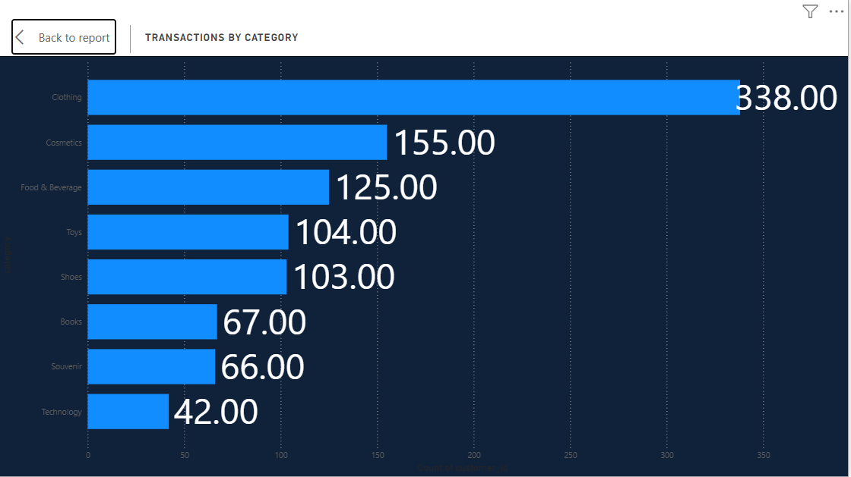
Category Analysis
Dashboard shows:
Business Insight:
Clothing is the highest revenue category.
Focus inventory and marketing on high-performing categories. Low-performing categories need promotional campaigns.
Shoes and Technology follow next.
Toys, Books, Souvenir have the lowest performance.

Slide 11
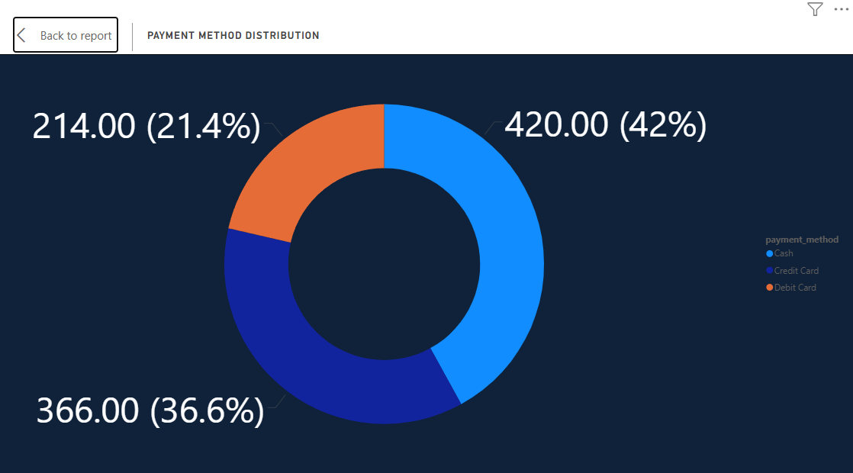
Payment Method Analysis
Charts indicate:
Cash: Majority of revenue
Credit Card: Second highest
Debit Card: Least used
Insight :
Customers prefer Cash or Credit Card → Offer cashback or EMI for card users.

Slide 12
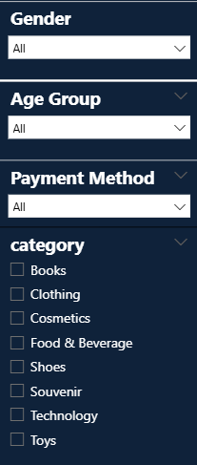
Interactive Slicers
The report contains slicers for:
Gender
Age Group
Category
Payment Method
Purpose:
These filters help users drill down to specific customer segments and analyze behavior effectively.

Slide 13
Combined Insights (Summary)
Top 6 Business Insights:
1
Female customers generate higher revenue than males.
2
Age group 46-60 is the most valuable customer segment.
3
Clothing leads all categories and drives maximum sales.
4
Cash is the most preferred payment method.
5
Customers aged 18-25 show lowest spending → opportunity for discounts.
6
Category + gender + age segmentation helps identify profitable customer groups.

Slide 14
SQL Queries Used
(Short version on PPT - full version will be provided separately)
Examples:
1. Total Revenue
SELECT SUM(quantity * price) AS total_revenue FROM customer;
2. Revenue by Gender
SELECT gender, SUM(quantity * price) AS revenue FROM customer GROUP BY gender;
3. Revenue by Age Group
SELECT
CASE
WHEN age BETWEEN 18 AND 25 THEN '18-25'
WHEN age BETWEEN 26 AND 35 THEN '26-35' WHEN age BETWEEN 36 AND 45 THEN '36-45' WHEN age BETWEEN 46 AND 60 THEN '46-60'
ELSE '60+'
END AS age_group,
SUM(quantity * price) AS revenue
FROM customer
GROUP BY age_group;
Note:
Full SQL Queries document is attached separately.

Slide 15
Conclusion
SQL & Power BI together helped identify customer behavior patterns.
The business can significantly increase revenue by focusing on:
Female customers
Age 26-60 groups
High-performing categories like Clothing
Power BI dashboard makes insights interactive and easy to use.

Slide 16

Recommendation
Launch personalized marketing for age groups 26-60
Improve digital offers for younger customers
Offer cashback/EMI for card payments
Increase stock for high-performing categories
Bundle offers for low-performing categories

